Slide 1
26b – Clean Code – Design Patterns - Factories
Based on the CleanCoders videos by Uncle Bob Martin
Rupert Waldron

Slide 2
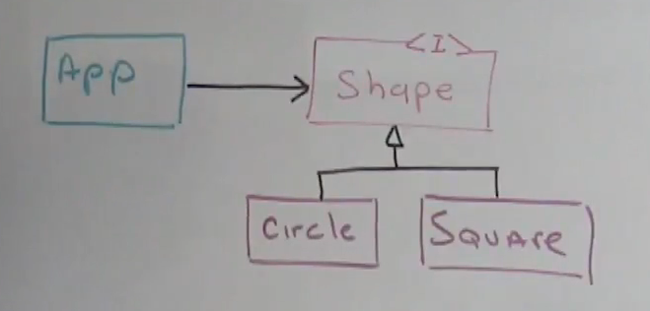
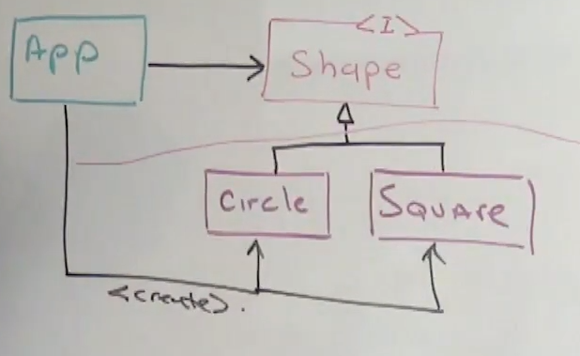
The Factory Pattern
Got an interface, were good to go!
App and Shape<I> can be shipped in a separate Jar to the shapes.
But wait how do we create the shapes…
We can use the magic of Spring to inject everything for us… Or

Slide 3
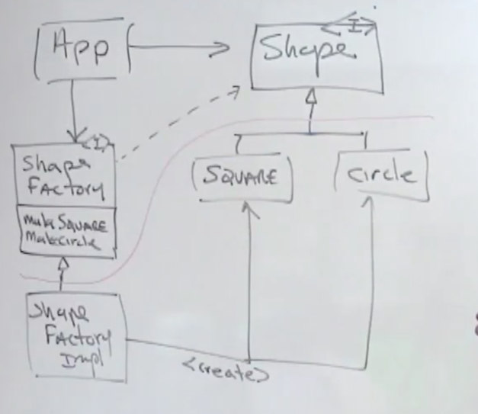

The Abstract Factory Pattern
Split the application like so
The classes above the line no nothing about the classes below the orange line…
We can package them into separate jars and ship them… and work on them separately. Lets have a look at the code.
We can use the magic of Spring to inject everything for us… Or

Slide 4
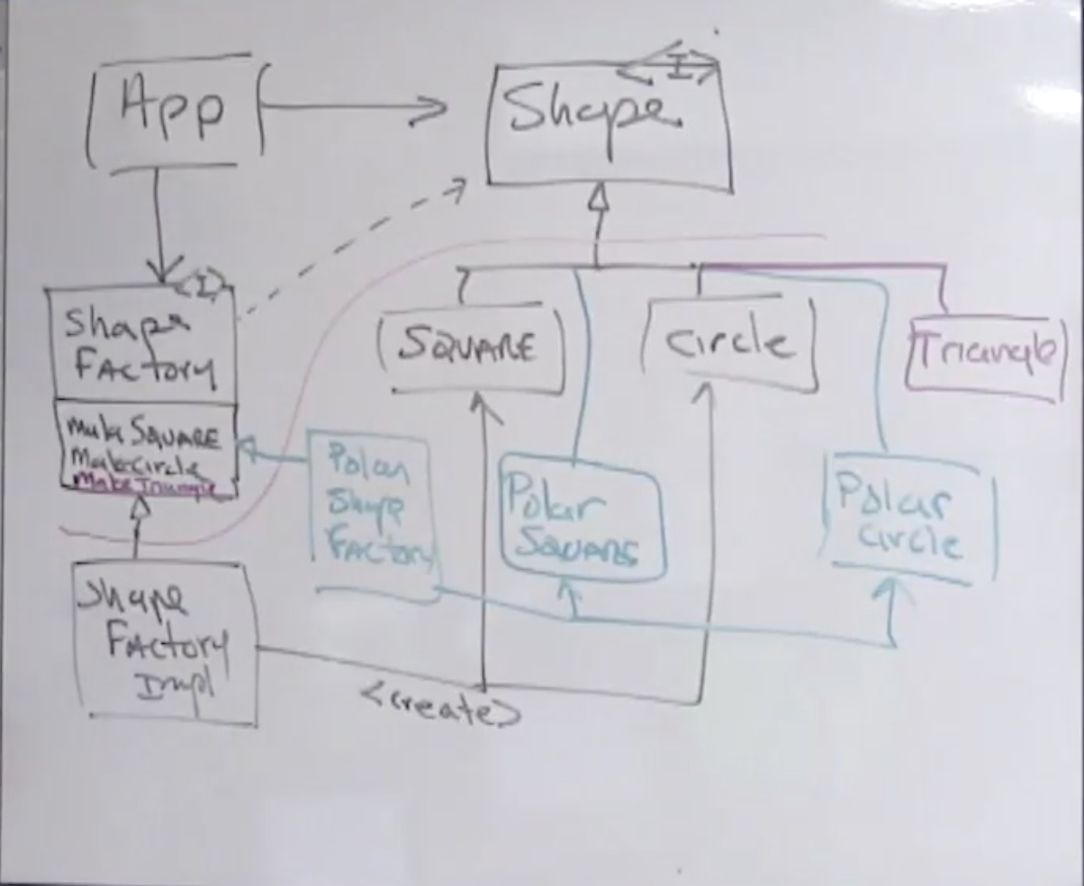

How to get around the type safety issue
Write some unit tests – they should pick up any type errors.
Quick look at the code..

Slide 5
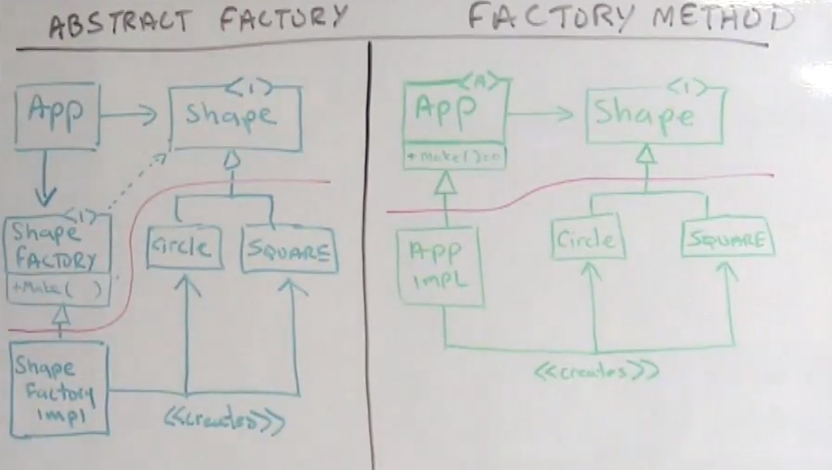
Other creation patterns – Factory Method
One advantage over abstract factory is you don’t need to pass in the factory – there is no “factory” you just create an instance of the application
Factory method is simpler and faster
Downside is you are just stuck with the one factory.
Lets see the code…

Slide 6
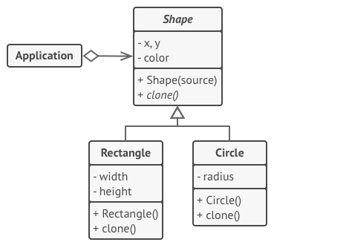
Other creation patterns – Prototype
The prototype pattern is logically equivalent to the abstract factory pattern but instead exchanges objects for methods

Slide 7
Other creation patterns – Prototype
public class ShapeApplicationUsingPrototype { public void runShapeApplication() throws Exception { Shape myCircle = (Shape) ShapePrototypes.circlePrototype.clone(); ((Circle) myCircle).setRadius(42); ((Circle) myCircle).setOrigin(new Point(3, 4)); Shape mySquare = (Shape) ShapePrototypes.squarePrototype.clone(); ((Square) mySquare).setSide(42); ((Square) mySquare).setTopLeft(new Point(10, 12)); Shape mySquare2 = (Shape) ShapePrototypes.squarePrototype.clone(); ((Square) mySquare2).setSide(5); ((Square) mySquare2).setTopLeft(new Point(7, 5)); System.out.println(myCircle.area()); System.out.println(mySquare2.area()); System.out.println(mySquare.area()); } }
You can clone objects without coupling to their concrete classes.
You can get rid of repeated initialization code in favour of cloning pre-built prototypes.
You can produce complex objects more conveniently.
You get an alternative to inheritance when dealing with configuration pre-sets for complex objects.
Cloning complex objects that have circular references might be very tricky.
You still need to set the correct class params after initialisation.
Still have same problem of knowing about a new shape… forfeit type-safety and use strings.

